Slide 1
Theory & Implementation of Grover’s Algorithm in IBM’s QISkit OpenQASM 2.0 Representation
GEORGE DAVILA, ALI AL KOBAISI, TYRONE THAMES

Slide 2

OUTLINE
Basics of Software/Hardware
Backend
Basic examples of circuits on IBMQX4
Grover’s Algorithm:
The Problem
Conceptual basics
Grover’s Algorithm:
Implementation on IBMQX
Results

Slide 3
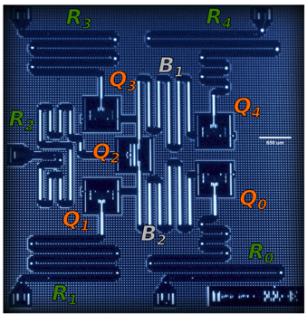
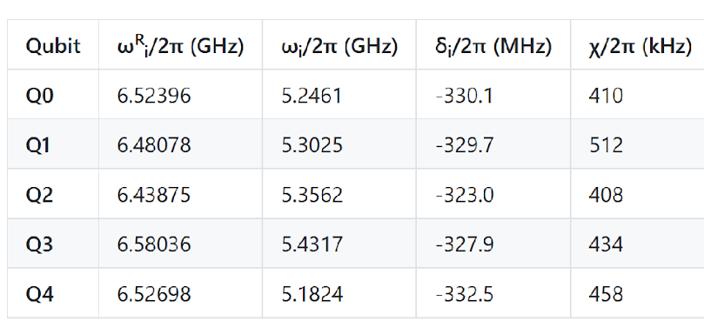
IBMQX4 CHIP
Parameters of the chip
5 qubit chip
ωR _{i} = Resonant frequency of readout resonator R _{i}
ω _{i} = qubit frequency
δ_{i} = anharmonicity, difference b/w freq of state 1→ 2 transmission and freq of state 0→1 transition
χ = qubit-cavity coupling strength

Slide 4
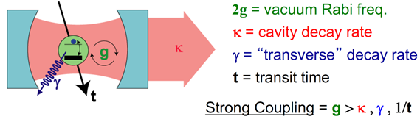
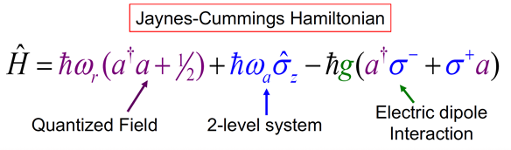
PHYSICS OF QUBIT-CAVITY SYSTEM
Described by cavity quantum electrodynamics (cQED)
Vacuum particles disturb the qubit → don’t have perfect coherence
Constitutes a Hybrid Quantum System → Dissipates into environment
Qubit Cavity

Slide 5
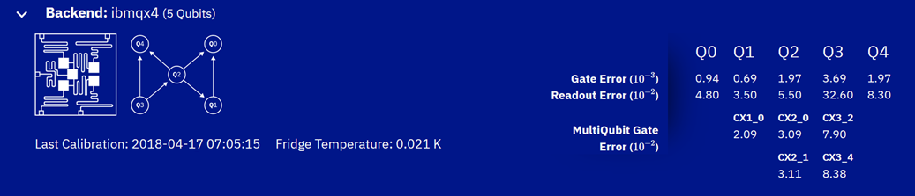
PHYSICS OF QUBIT-CAVITY SYSTEM
Keep at low temperature T = 0.021 K to help preserve coherence
(Retrived April 7th appx 15:00)

Slide 6
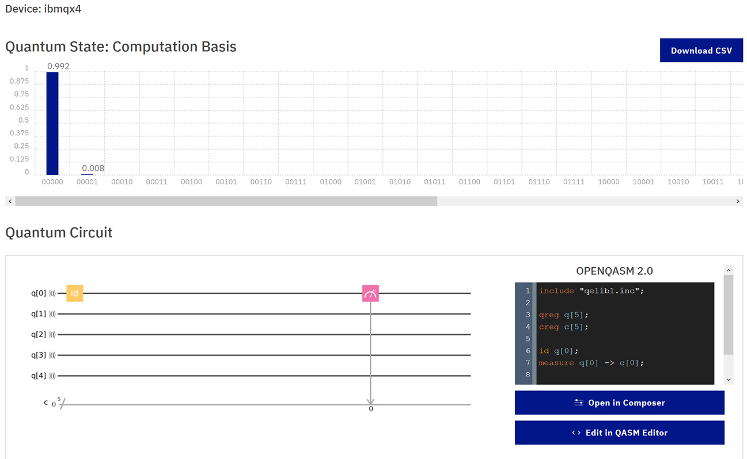
SIMPLE EXAMPLES OF IMPLEMENTATION
Should yield result of 1 on 00000, but since it’s using actual qubit it decoheres and leaks into the 00001 state a bit
No entanglement here

Slide 7
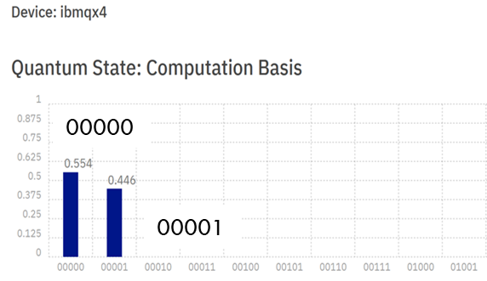
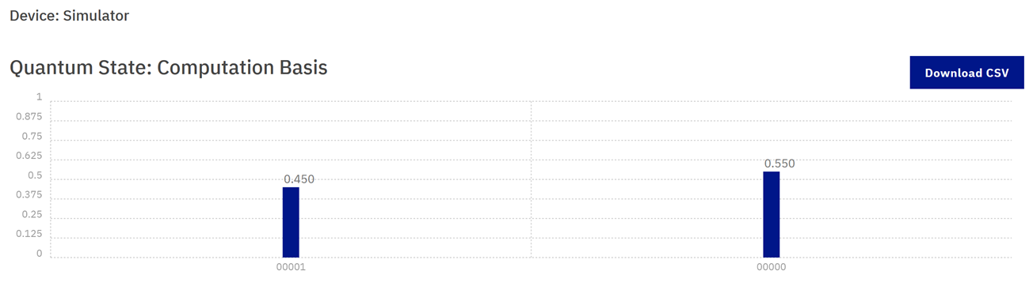
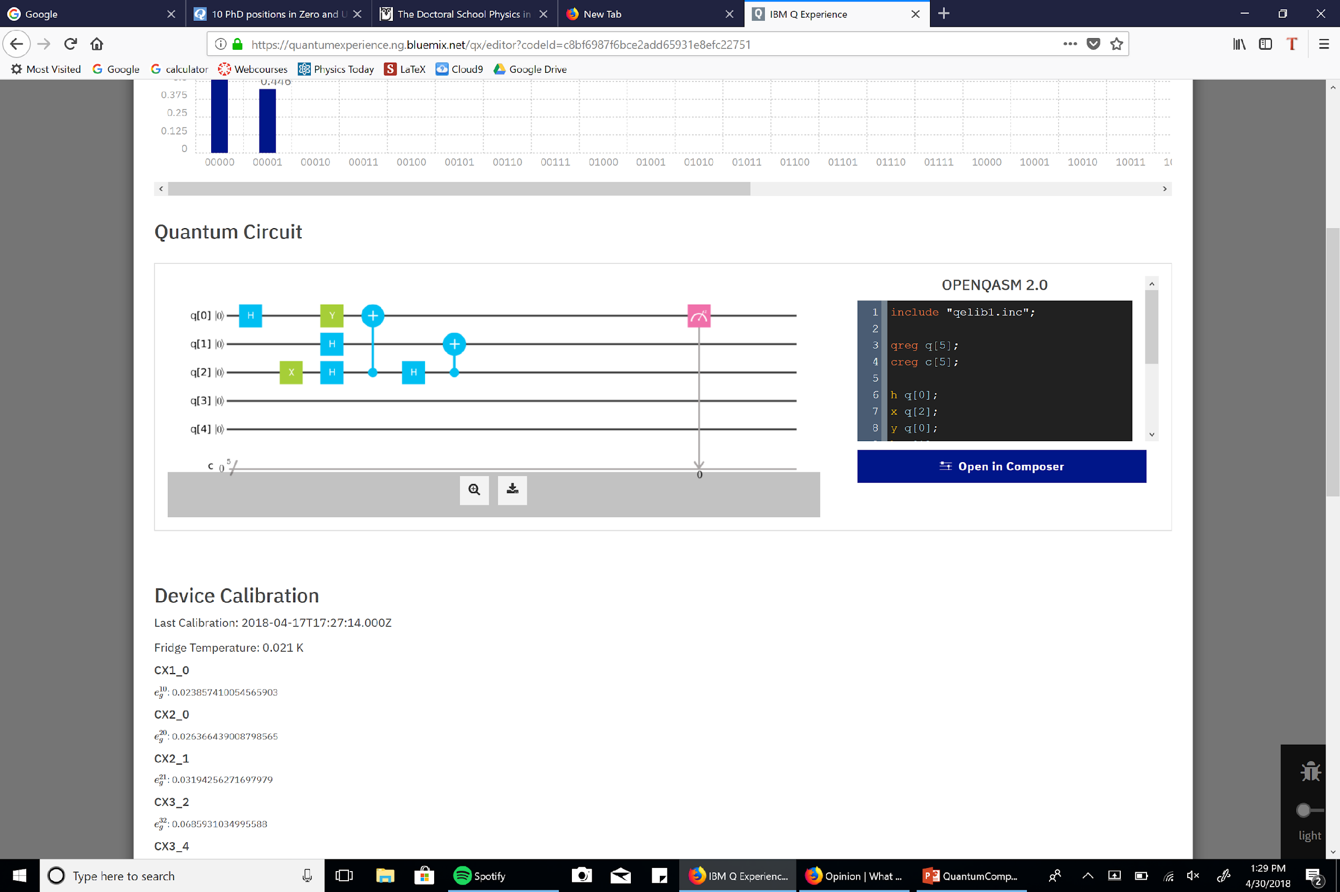
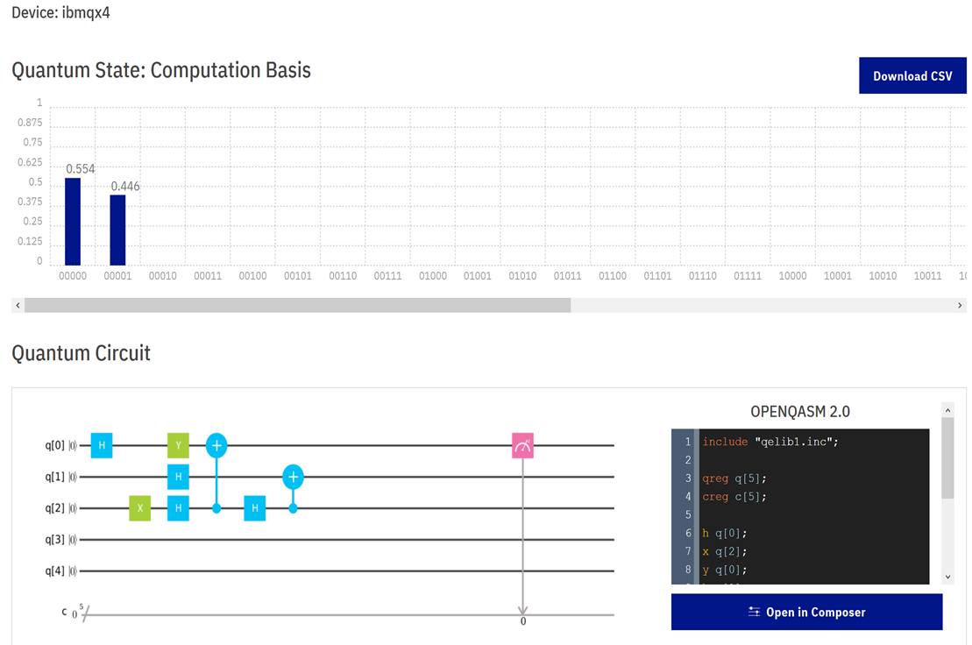
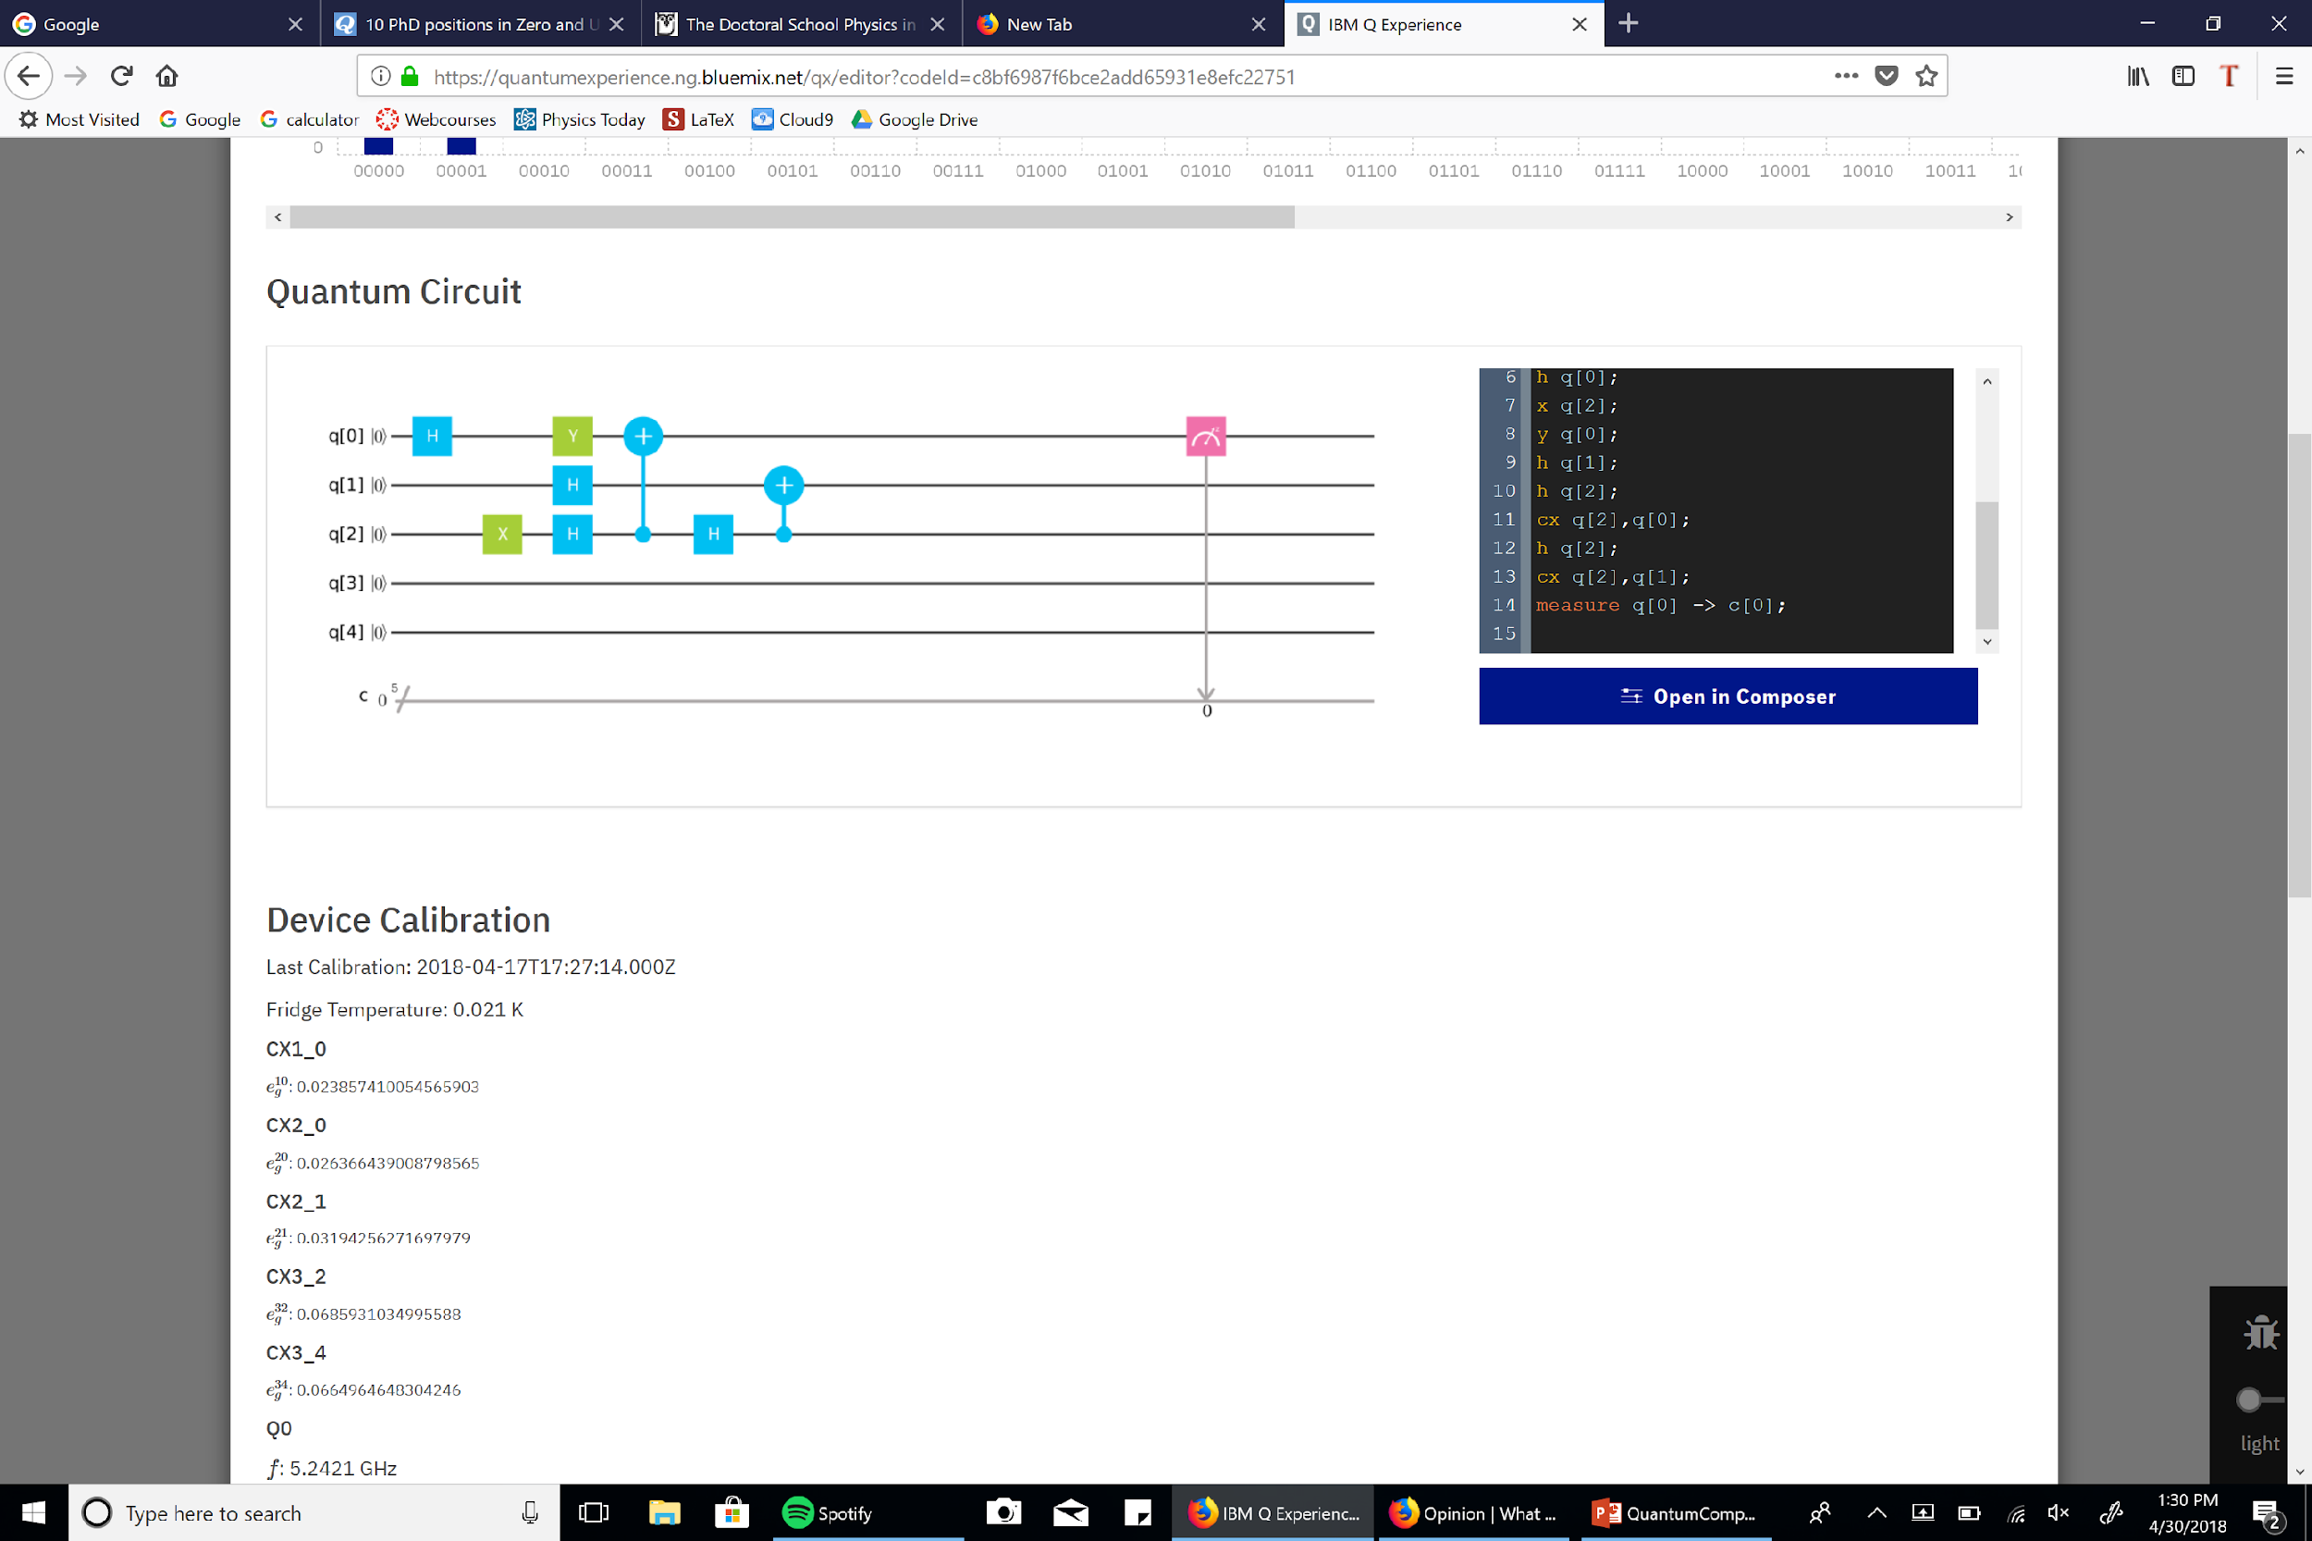
Ibmqx4 chip
Simulation of circuit
00001
00000

Slide 8
GROVER’S ALGORITHM
QISKIT OPENQASM 2.0 REPRESENTATION

Slide 9
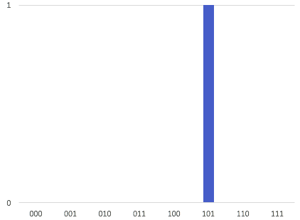
THE PROBLEM
Given a Boolean black box 𝑓 : {0, 1, …, 2^{𝑛}−1} → {0, 1} that indicates whether a given item is marked.
The problem is to find the marked item given that one exists.

Slide 10
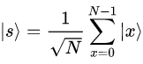
GROVER’S ALGORITHM
Starts by preparing the superposition of all bases using Hadamard gates. Repeat sqrt(𝑁) times: Apply, 𝑓, the black box operation. Apply reflection across the average.

Slide 11
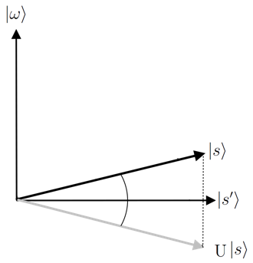
GEOMETRICALLY
The black box (phase oracle) reflects the current state around the uniform superposition of all unmarked bases.

Slide 12
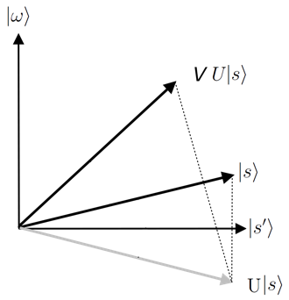
GROVER’S DIFFUSION OPERATION
After application of the oracle, the state can be pushed towards 𝜔 by a reflection around |s⟩.
The operation for this reflection is:
𝑉 = 𝐼 - 2|s⟩⟨s| = 𝐻 (𝐼 - 2|0⟩⟨0|) 𝐻

Slide 13
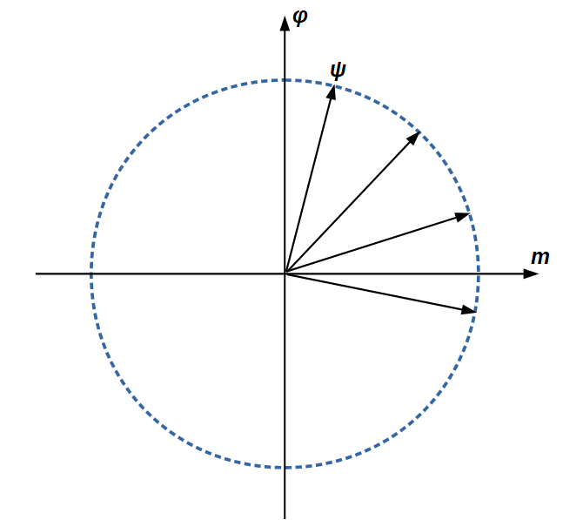
N = 16
The process can be repeated 3 times

Slide 14
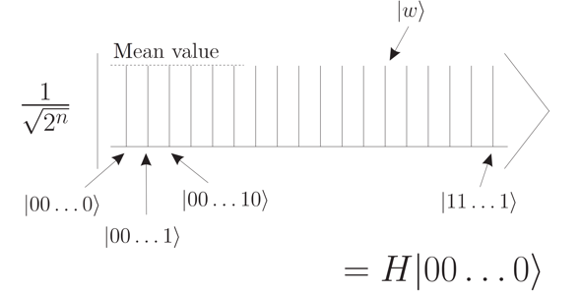
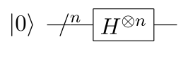
SUPERPOSITION OF ALL BASES

Slide 15
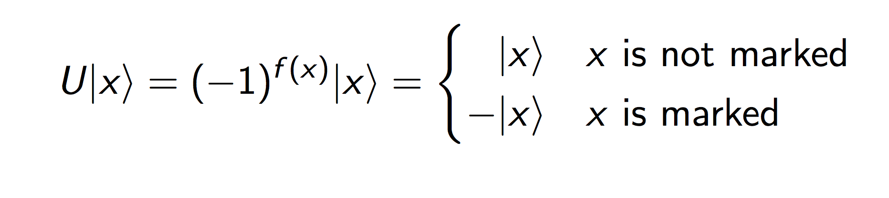
PHASE ORACLE
f can be written as a reversible operation as:

Slide 16
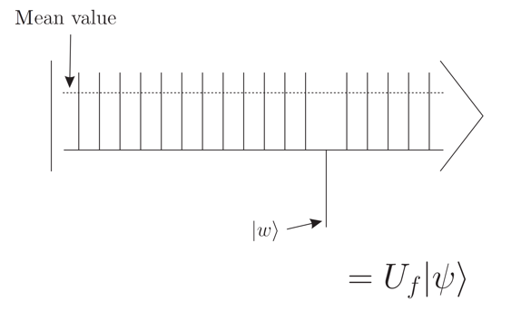
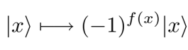
FIRST OPERATION / REFLECTION

Slide 17
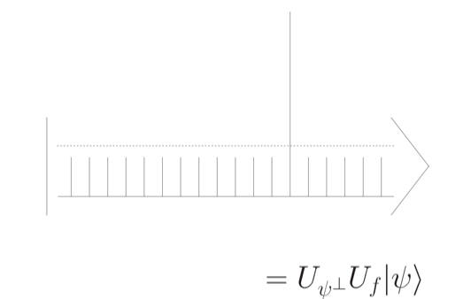
REFLECTION ACROSS THE AVERAGE
After 2nd reflection:
𝑉 = 𝐼 - 2|s⟩⟨s|

Slide 18
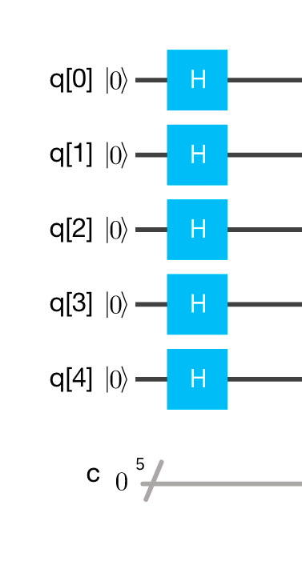
IMPLEMENTATION
Prepare the state of superposition of all bases using Hadamard gates.
for i in range(N):
circuit.h(q_register[i])

Slide 19
IMPLEMENTATION / REFLECTION ABOUT |000…0⟩
Pauli Z gate:
|0⟩ ⟼ |0⟩
|1⟩ ⟼ -|1⟩
Controlled Z:
|00⟩ ⟼ |00⟩
|01⟩ ⟼ |01⟩
|10⟩ ⟼ |10⟩
|11⟩ ⟼ -|11⟩
We need operator:
I - 2|0⟩⟨0|
that maps:
|0⟩ ⟼ -|0⟩
|x⟩ ⟼ |x⟩

Slide 20
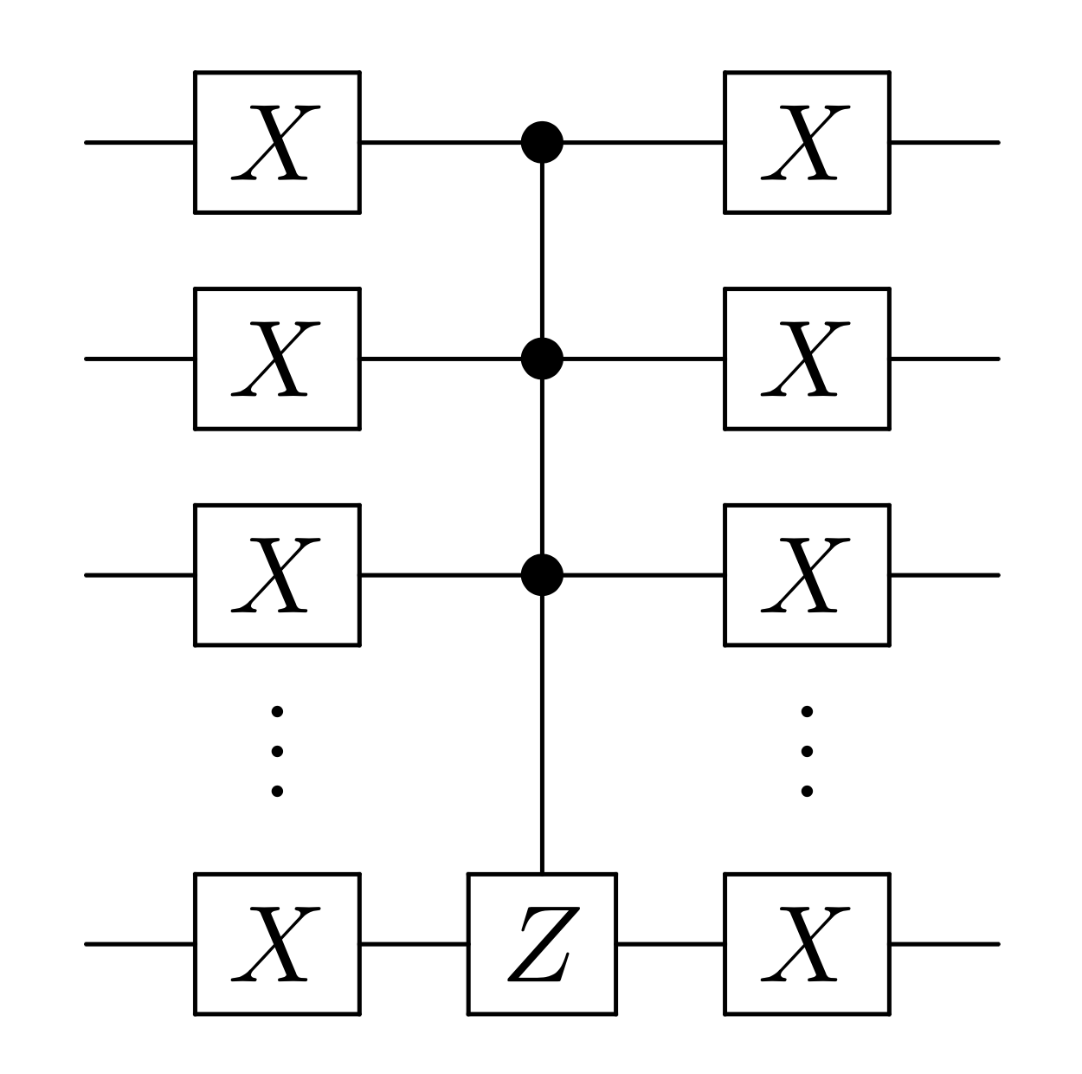
IMPLEMENTATION / REFLECTION USING CONTROLLED Z
NOT Controlled Z NOT:
|00⟩ ⟼ -|00⟩
|01⟩ ⟼ |01⟩
|10⟩ ⟼ |10⟩
|11⟩ ⟼ |11⟩
NOT^{⊗n} C^{n-1}Z NOT^{⊗n}
Giacomo Nannicini, “An Introduction to Quantum Computing, Without the Physics”, 2018

Slide 21
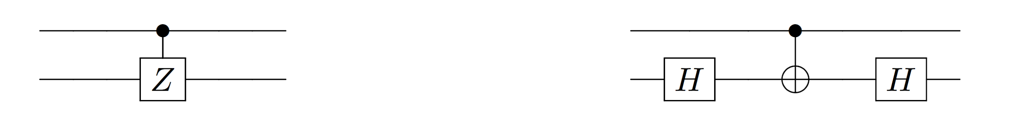
IMPLEMENTATION / CONTROLLED Z USING CNOT
There is no Controlled Z operator in QISKit.
But Z operator is equal to:
Z = H NOT H
Therefore Controlled Z can be written as:
CZ = (I⊗H) CNOT (I⊗H)

Slide 22
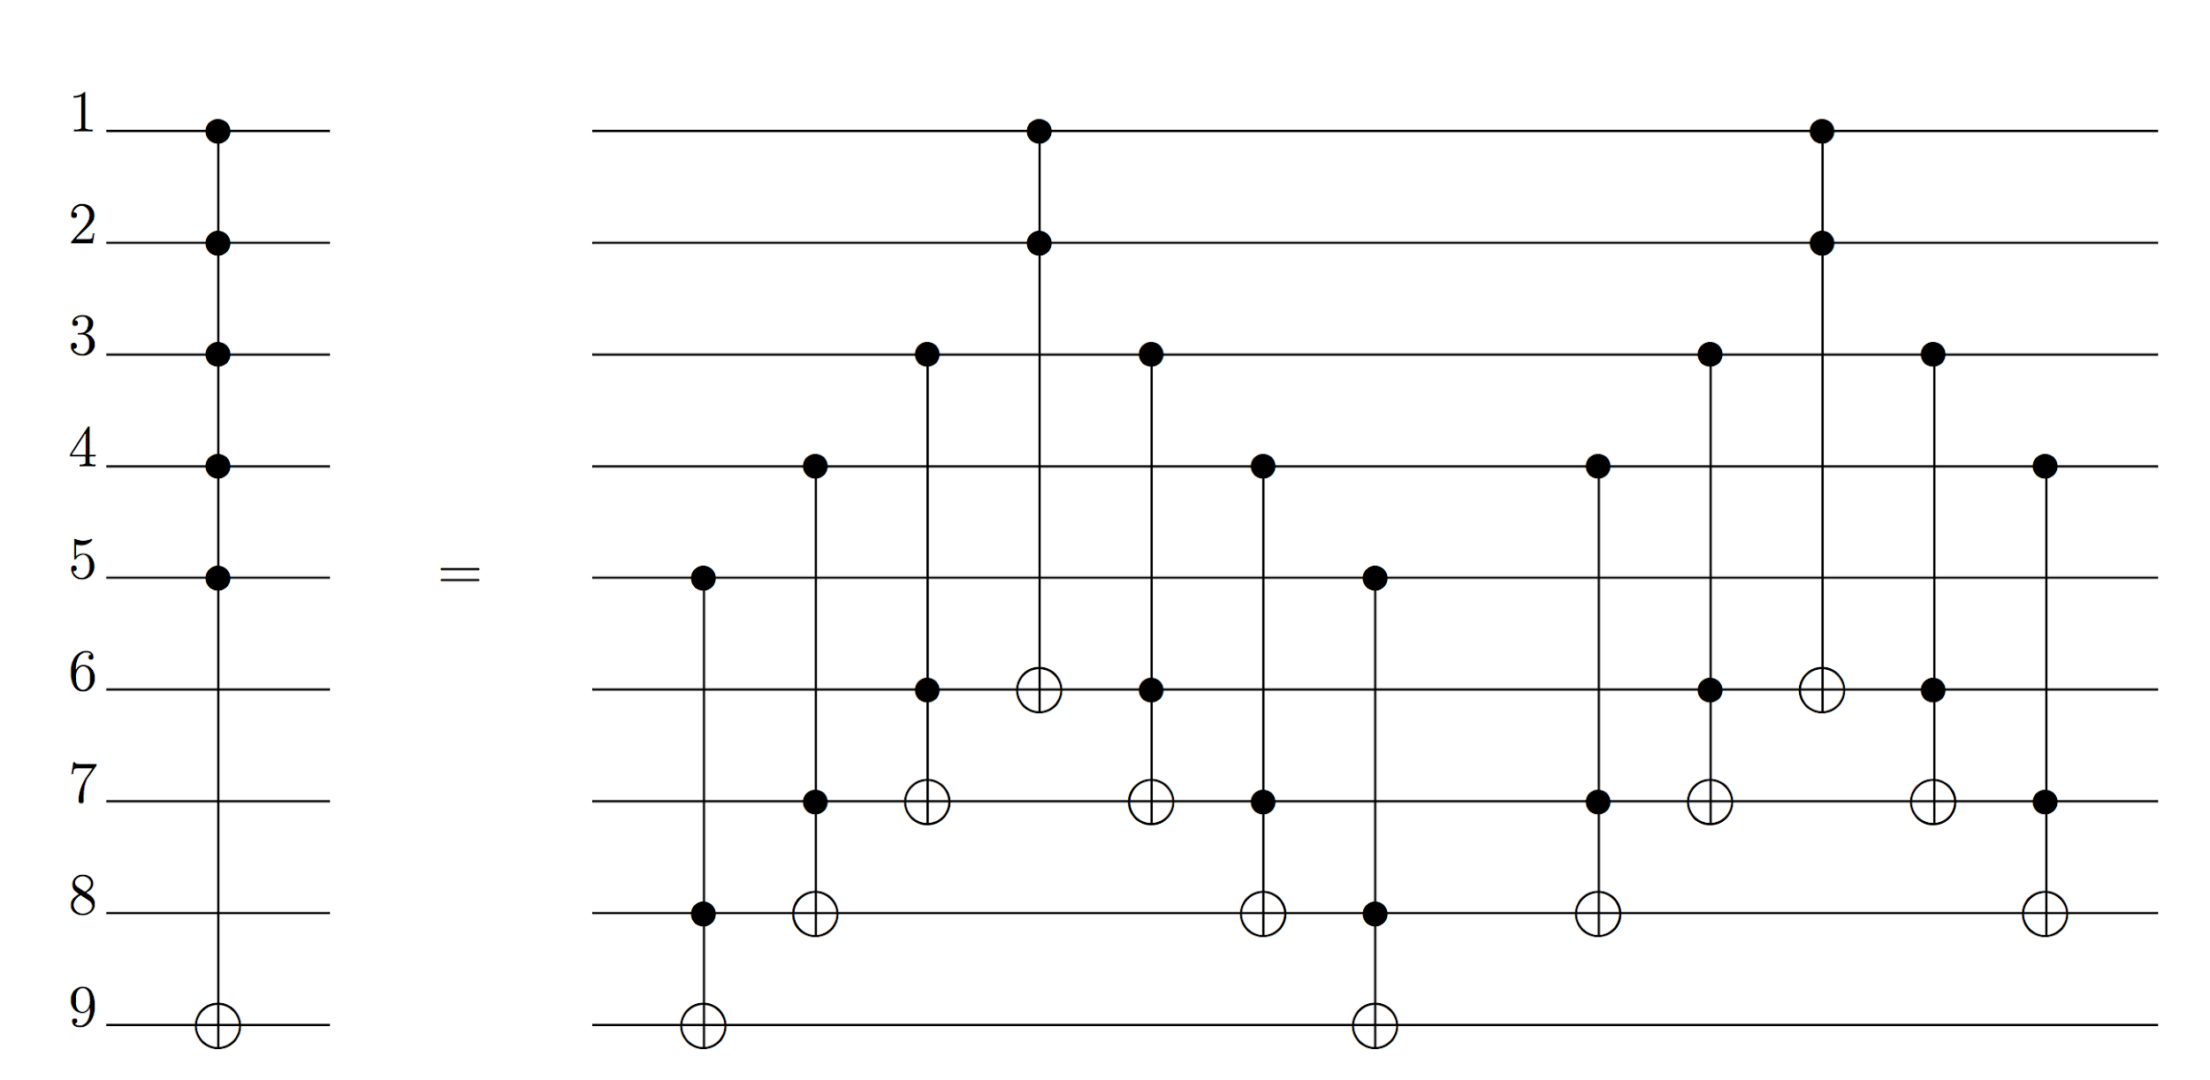
IMPLEMENTATION / N CONTROLLED NOT
Adriano Barenco et. al, “Elementary gates for quantum computation", Quantum Physics, 1995, Lemma 7.2.

Slide 23
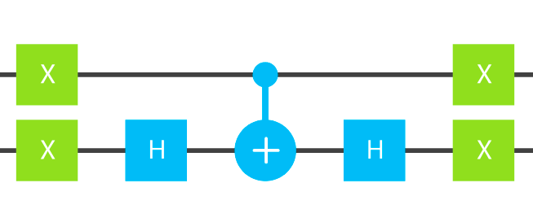
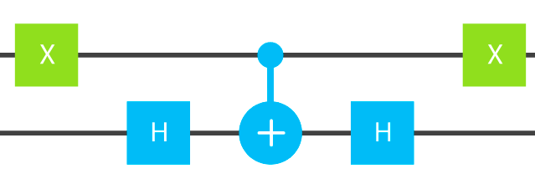
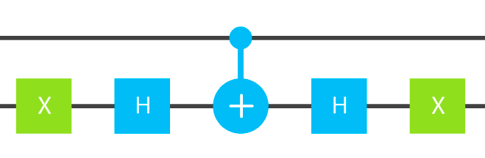
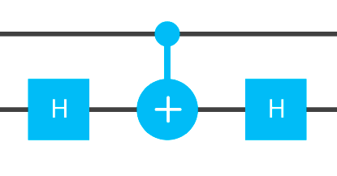
IMPLEMENTATION / PHASE ORACLE
|00⟩ ⟼ -|00⟩
|10⟩ ⟼ -|10⟩
|01⟩ ⟼ -|01⟩
|11⟩ ⟼ -|11⟩

Slide 24
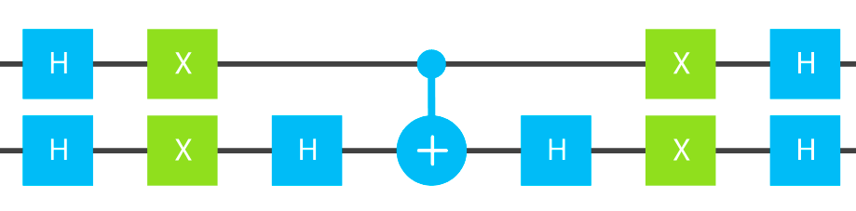
IMPLEMENTATION / REFLECTION ACROSS AVERAGE
So:
𝐼 - 2|s⟩⟨s|
can be implemented as:
H^{⊗n} NOT^{⊗n} CZ NOT^{⊗n} H^{⊗n}
For 2 qbits:

